Slide 1
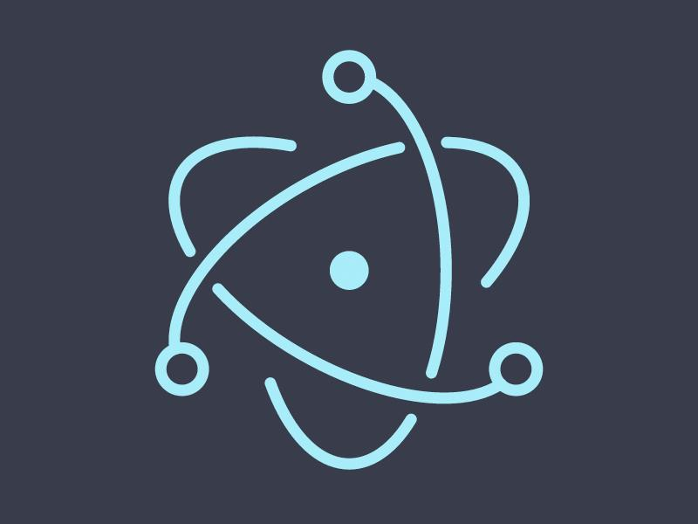
Electron
Andrew Souvanlasy, Theoren Weber

Slide 2
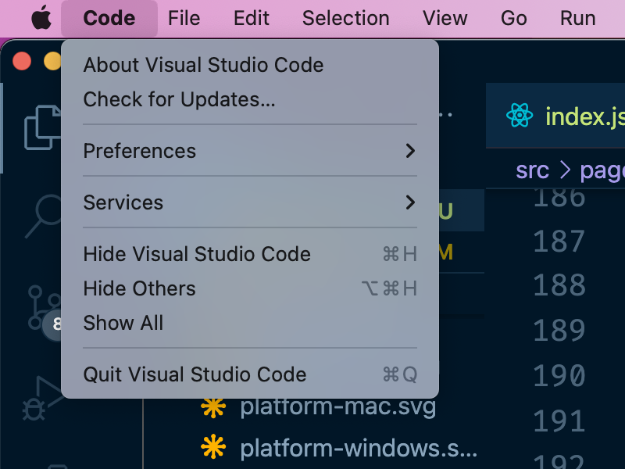
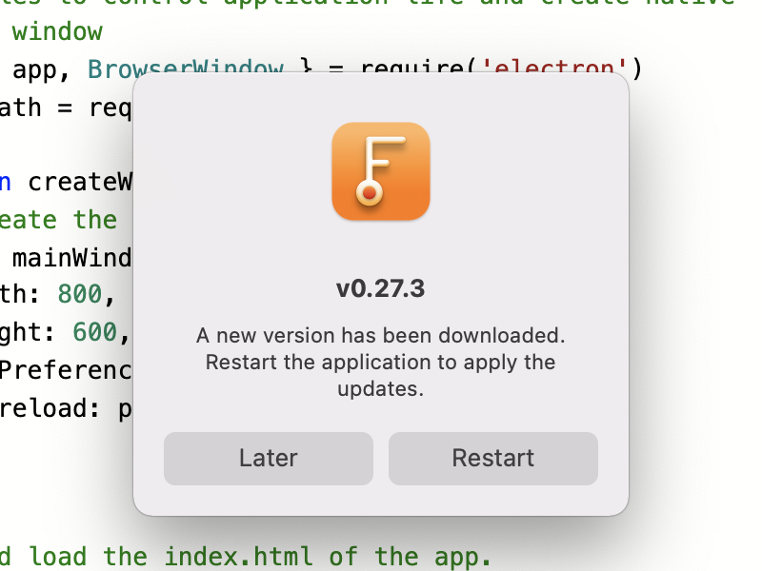
What is Electron?
Electron is a cross-platform app development framework
Windows, Mac, and Linux
Only one codebase to develop for!
Runs in a Node.js Chromium environment
Uses HTML, CSS, and JavaScript for UI and functionality
Easily create installers or publish to an app store
Open source

Slide 3
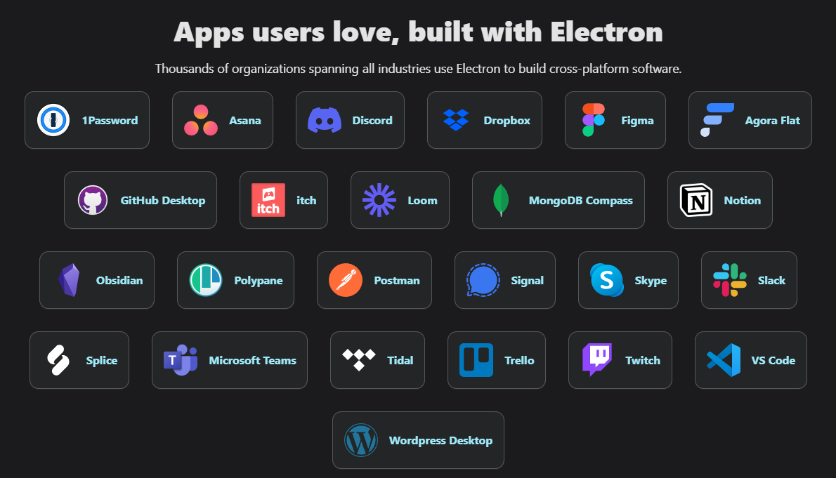

Slide 4
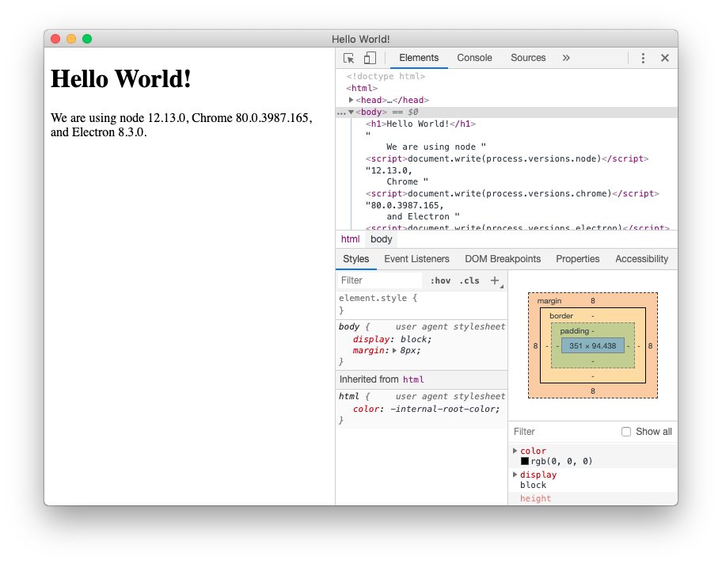
Let’s make our own app!
By the end of the lesson, you will be able to:
Load an interactive HTML page
Move back and forth between different windows
Export an executable application for your OS

Slide 5
npm init
{
"name": "electron-app",
"version": "1.0.0",
"description": "Hello World!",
"main": "main.js",
"author": "Joe Mama",
"license": "MIT"
}

Slide 6
npm i --save-dev electron
The run command in package.json:
{
"scripts": {
"start": "electron ."
}
}

Slide 7
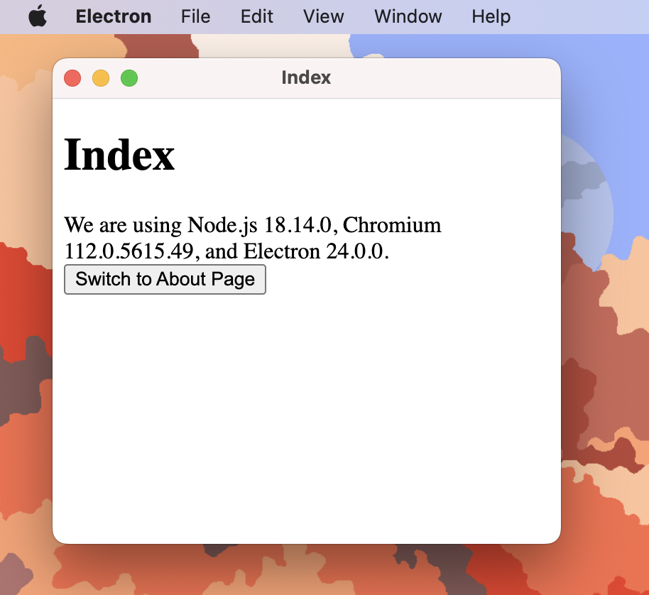
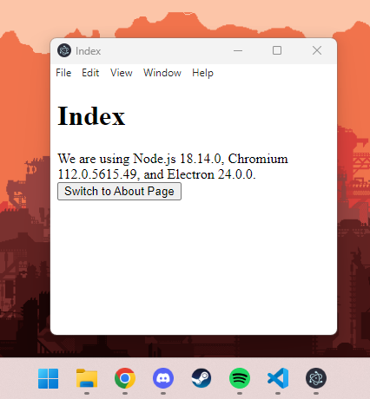
App window differences between OSes

Slide 8


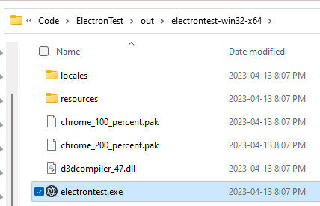
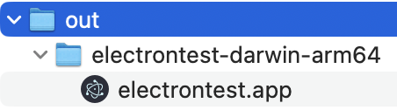
npm install --save-dev @electron-forge/cli
npx electron-forge import
npm run make
ARM build (newer Macs)
Intel/AMD 64-bit build (most PCs)

Slide 9
Where to go next
Electron apps are usually single-page applications, using UI frameworks like React, Vue, or Angular.
The problem with loading normal HTML documents is that:
The page state is reset. You lose whatever info the DOM has (ex. user info).
There can be large layout shifts and a blank white screen as the HTML is loaded in

Slide 10
Electron Docs
https://www.electronjs.org

Slide 11
Questions?

